Slide 1
Probability Distributions Geometric, Uniform, Beta

Slide 2
The Geometric and Negative Binomial Distribution
On page 67 we indicated that a countably infinite(finitely many or infinitely many) sample space would be needed if we are interested in the number of cars persons have to inspect until they find one whose nitrogen oxide emission does not meet government standards.
To treat this kind of problem in general, suppose that in a sequence of trials we are interested in the number of the trial on which the first success occurs.
The three assumptions for Bernoulli trials are satisfied but the extra assumption underlying the binomial distribution is not. In other words, n is not fixed.

Slide 3


l
Clearly, if the first success is to come on the xth trial, it has to be receded by x − 1 failures, and if the probability of a successes is p, the probability of x − 1 failures in x − 1 trials is $({1−p)}^{x−1}$. Then, if we multiply this expression by the probability p of a success on the xth trial, we find that the probability of getting the first success on the xth trial is given by
This probability distribution is called the geometric distribution.

Slide 4

Mean and Variance

Slide 5
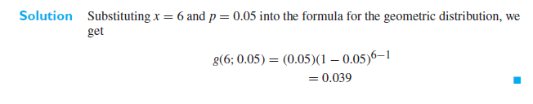
Problem
If the probability is 0.05 that a certain kind of measuring device will show excessive drift, what is the probability that the sixth measuring device tested will be the first to show excessive drift?

Slide 6
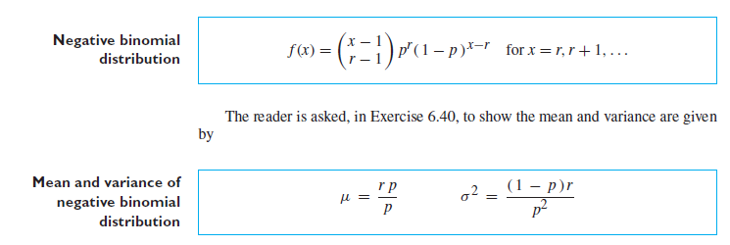
Negative Binomial
The negative binomial distribution describes the total number of Bernoulli trials, X, to obtain a specified number r successes. When r=1, the negative binomial reduces to the geometric distribution. If the rth success occurs at trial number x, it must be that r−1 successes occurred in the first x − 1 trials and the last trial is a success. The probability distribution is then the product of the binomial probability b ( r − 1 ; x − 1, p ) and p.

Slide 7
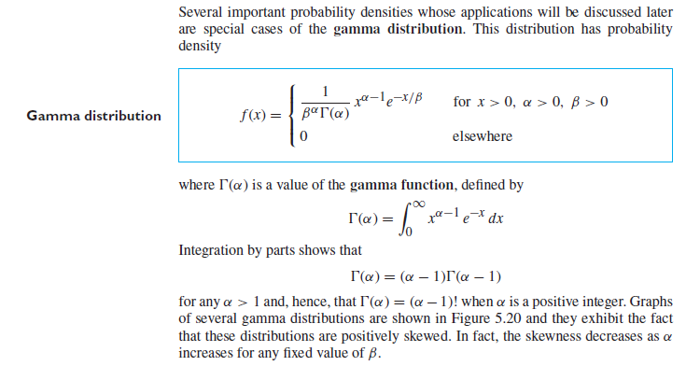
Gamma Distribution

Slide 8
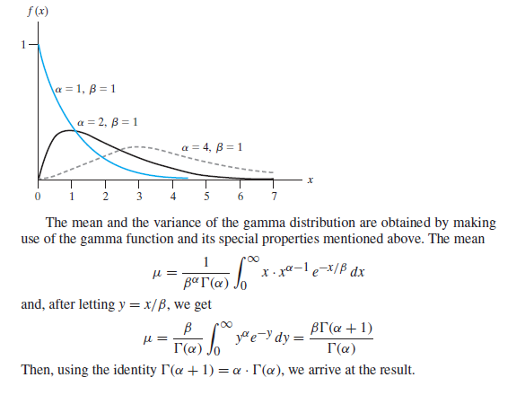
Graph of some gamma probability density functions

Slide 9
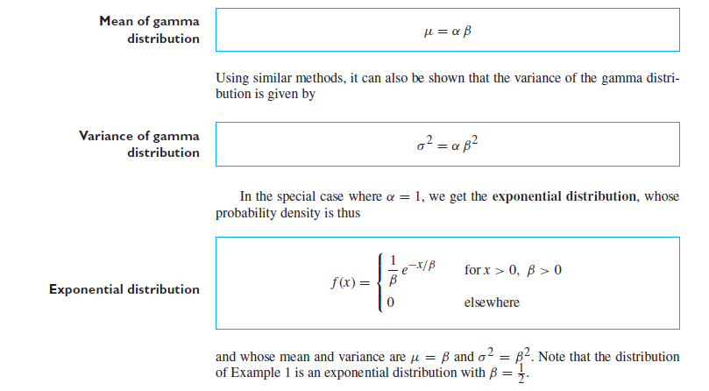

Slide 10
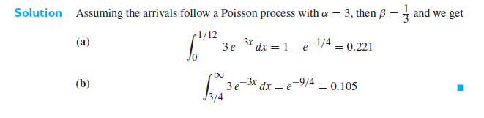
Problem
With reference to the example on page 124,( If the probability is 0.05 that a certain kind of measuring device will show excessive what is the probability that the sixth measuring device tested will be the first to show excessive drift?) drift, where on the average three trucks arrived per hour to be unloaded at a warehouse, what are the probabilities that the time between the arrival of successive trucks will be (a) less than 5 minutes? (b) at least 45 minutes?

Slide 11
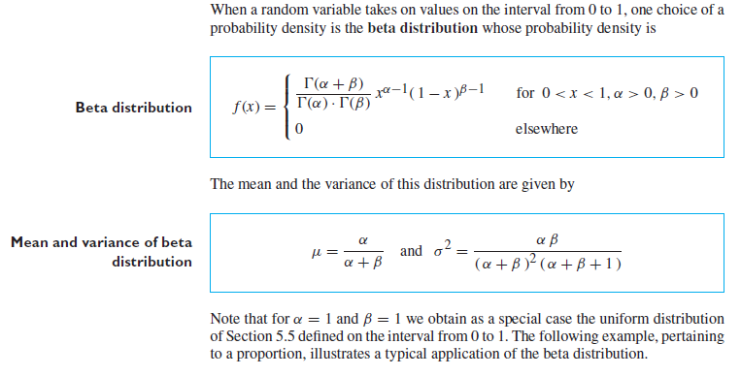
Beta

Slide 12
Problem
In a certain county, the proportion of highway sections requiring repairs in any given year is a random variable having the beta distribution with α = 3 and β = 2 (shown in Figure 5.22).

Slide 13
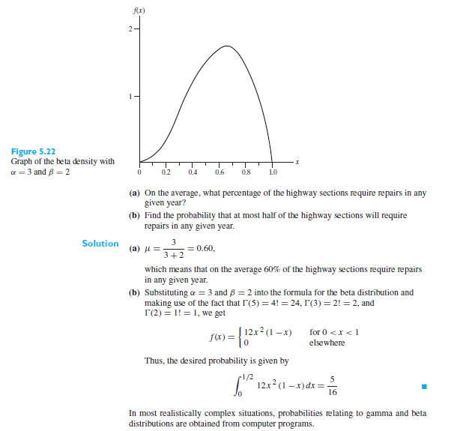

Slide 14
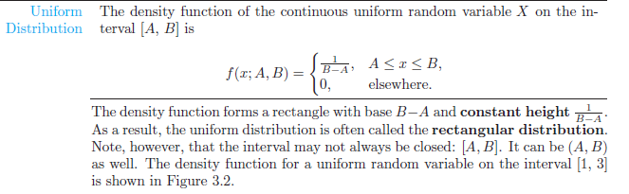
Uniform distribution
One of the simplest continuous distributions in all of statistics is the continuous uniform distribution. This distribution is characterized by a density function that is “flat,” and thus the probability is uniform in a closed interval, say [A, B].

Slide 15
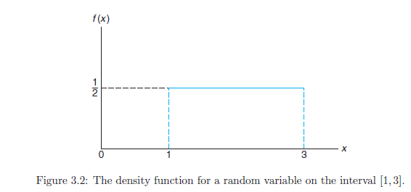
Probabilities are simple to calculate for the uniform distribution because of the simple nature of the density function. However, note that the application of this distribution is based on the assumption that the probability of falling in an interval of fixed length within [A, B] is constant

Slide 16
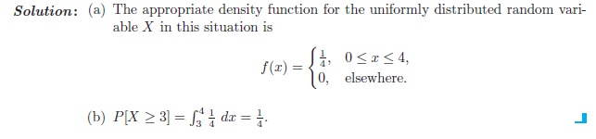
Problem:
Suppose that a large conference room at a certain company can be reserved for no more than 4 hours. Both long and short conferences occur quite often. In fact, it can be assumed that the length X of a conference has a uniform distribution on the interval [0, 4].
(a) What is the probability density function?
(b) What is the probability that any given conference lasts at least 3 hours?

Slide 17


